Slide 1
DSA PROJECT
HOSPITAL MANAGEMENT SYSTEM USING linked list

Slide 2
PROJECT DESCRIPTION
This project allows the user to book patients appointment on the basis of their disease. It will also allow them to remove the patients record after their treatment and also allow them to search the patient record.
We used the data structure and algorithms concepts like structures, linked list etc. structures has been used for data collection and linked list concept has been used for storing the data .

Slide 3
Insertion
Allocate memory for new node
Store data
Change next of new node to point to head
Change head to point to recently created node

Slide 4
Insert at the End
Allocate memory for new node
Store data
Traverse to last node
Change next of last node to recently created node

Slide 5
Insert at the Middle
Allocate memory and store data for new node
Traverse to node just before the required position of new node
Change next pointers to include new node in between

Slide 6
Delete from beginning
Point head to the second node

Slide 7
Delete from end
Traverse to second last element
Change its next pointer to null

Slide 8
Delete from middle
Traverse to element before the element to be deleted
Change next pointers to exclude the node from the chain

Slide 9
Applications of linked list
Implementation of stacks and queues
Implementation of graphs.
Dynamic memory allocation: We use a linked list of free blocks.
Maintaining a directory of names
Performing arithmetic operations on long integers
Manipulation of polynomials by storing constants in the node of the linked list
Representing sparse matrices

Slide 10
Main Features
Home page
Addition
Deletion
Display
user will enter fill the information and appointment would be booked according to Disease.
User can delete the appointment (basically deletes first appointment).
Displays the appointment list with the information

Slide 11
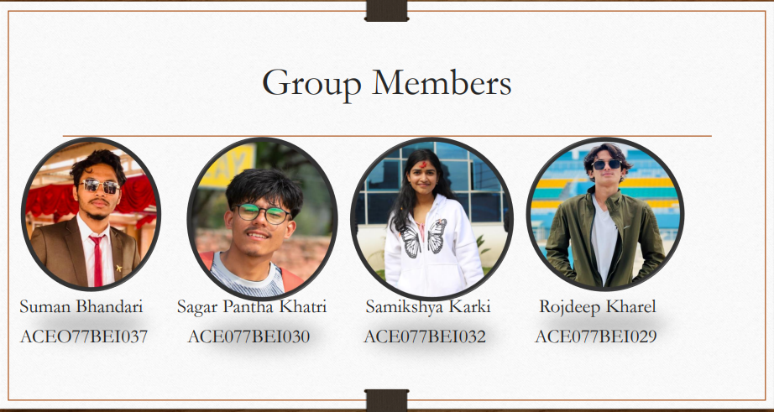


Group Members
Suman Bhandari Samikshya Karki
ACEO77BEI037 ACE077BEI032

